Slide 1
Progressive web apps
A new way to deliver amazing user experiences on the web.

Slide 2
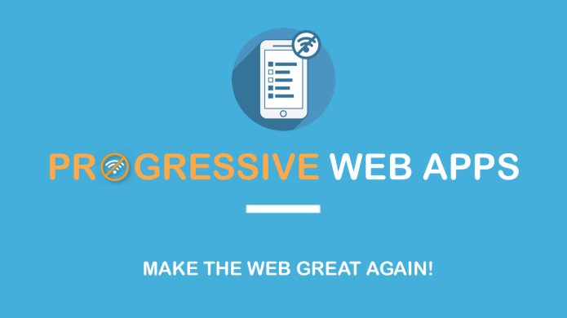



Slide 3

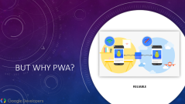
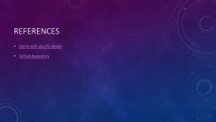
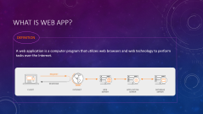
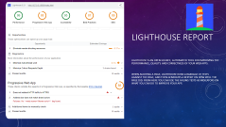
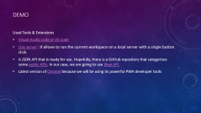
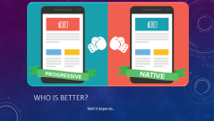
What we will talk about

Slide 4
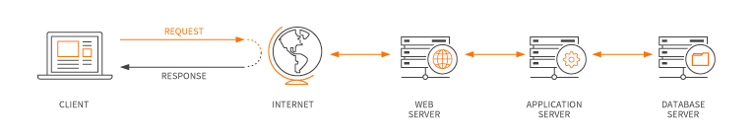
What is web app?
​DEFINITION
A web application is a computer program that utilizes web browsers and web technology to perform tasks over the Internet.

Slide 5


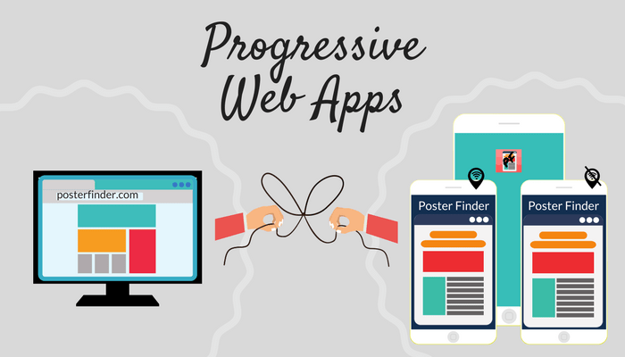
What is Progressive web apps?
A Progressive Web App (PWA) is a web app that uses modern web capabilities to deliver an app-like experience to users.

Slide 6


What Is Progressive Enhancement
Progressive enhancement is a strategy for web design that emphasizes core webpage content first. It then adds more layers of complexity.

Slide 7

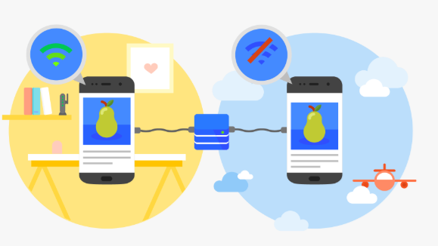

But why PWA?
RELIABLE

Slide 8
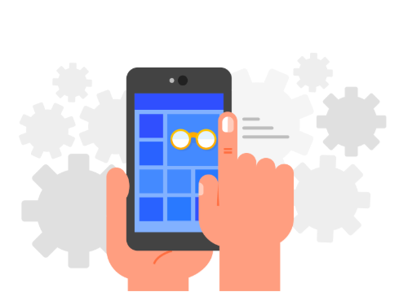
But why PWA?
FAST

Slide 9
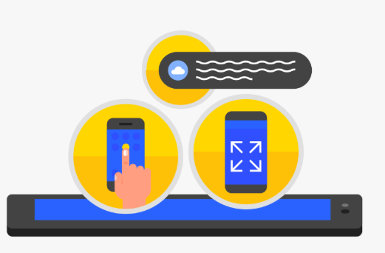
But why PWA?
ENGAGING

Slide 10
Progressive
App-like
Connectivity independent
Responsive
Safe
Fresh
Discoverable
Re-engageable
Linkable
Installable
But why PWA?

Slide 11
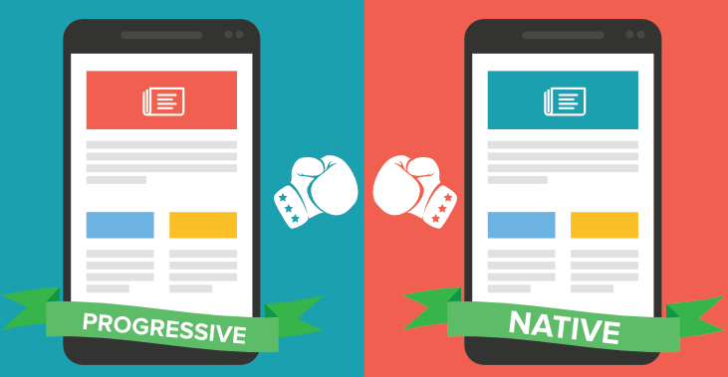
Who is better?
Well it depends.

Slide 12
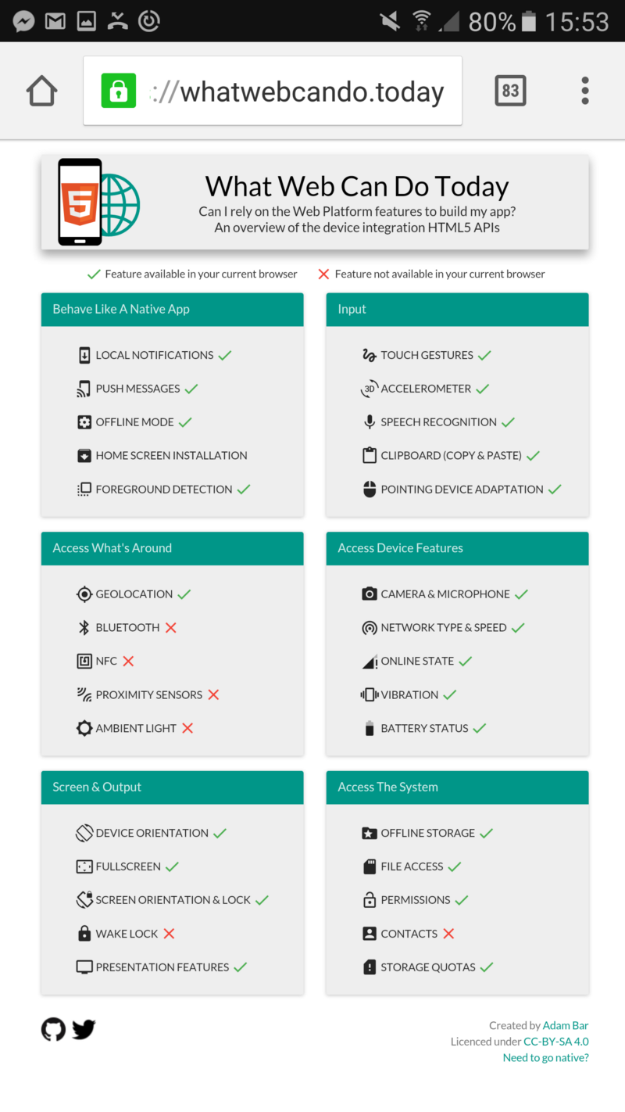
PWA VS Native
Android
PWA support most of the features provided by native applications.
IOS
PWA support is “almost there” now that Safari 11.1 has added support for Service Workers with Safari 11.1, released on March 30, 2018 and available on iOS 11.3 and macOS 10.11 or later. Push notifications don’t work yet and there are some other low-level feature limitations compared to native apps, but Mac OS Safari push notifications do work.

Slide 13
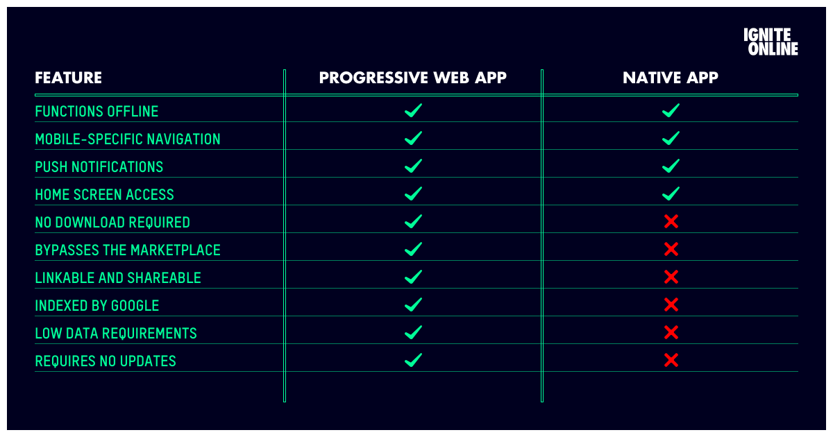

Slide 14
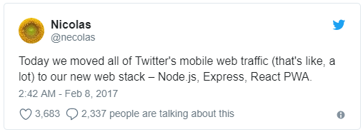
Twitter uses pwa
https://pwa.rocks

Slide 15
DEMO
Used Tools & Extensions
Visual studio code or VS Code
Live server : It allows to run the current workspace on a local server with a single button click.
A JSON API that is ready for use. Hopefully, there is a GitHub repository that categorizes some public APIs. In our case, we are going to use Jikan API.
Latest version of Chrome because we will be using its powerful PWA developer tools

Slide 16
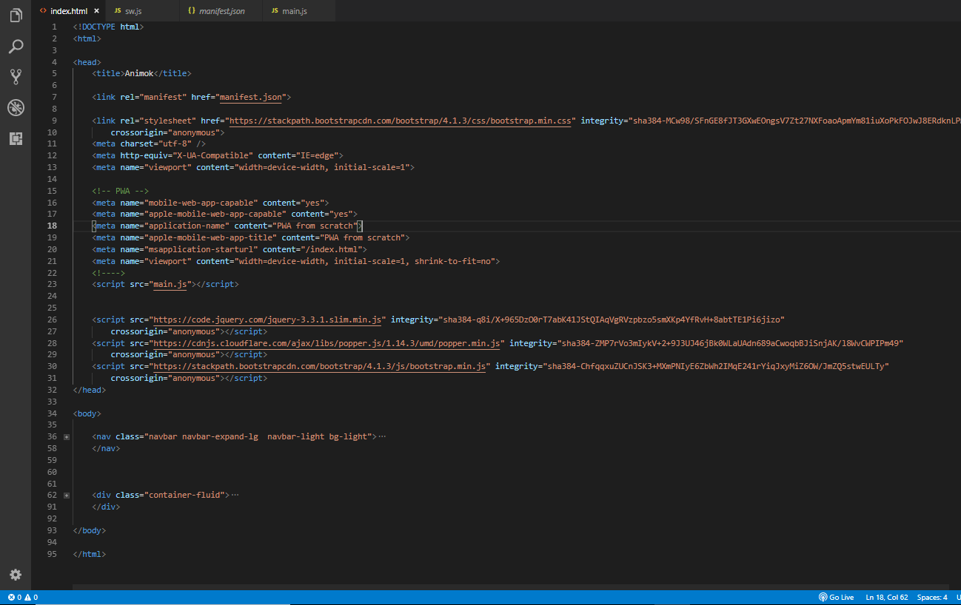
Index.html
APP SHELL

Slide 17
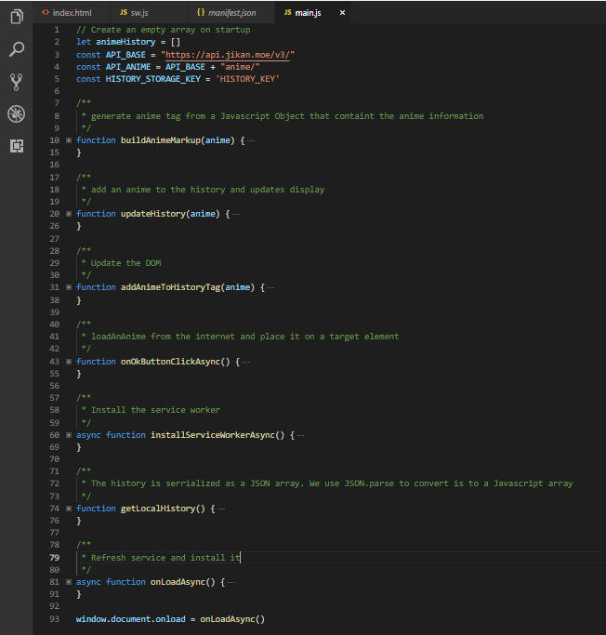
APP SHELL
Main.js

Slide 18
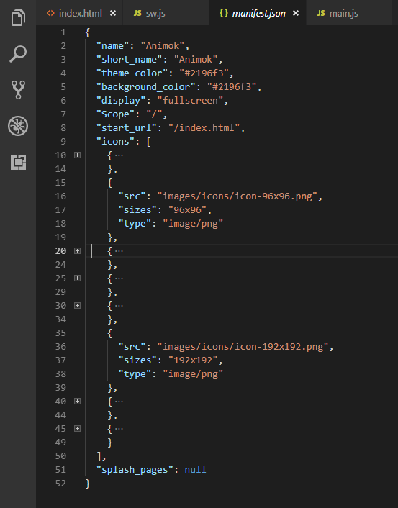

Manifest.json
The web app manifest provides information about an application (such as its name, author, icon, and description) in a JSON text file. The manifest informs details for websites installed on the homescreen of a device, providing users with quicker access
You can use Web App Manifest Generator to generate manifest file to you with all icon sizes.

Slide 19
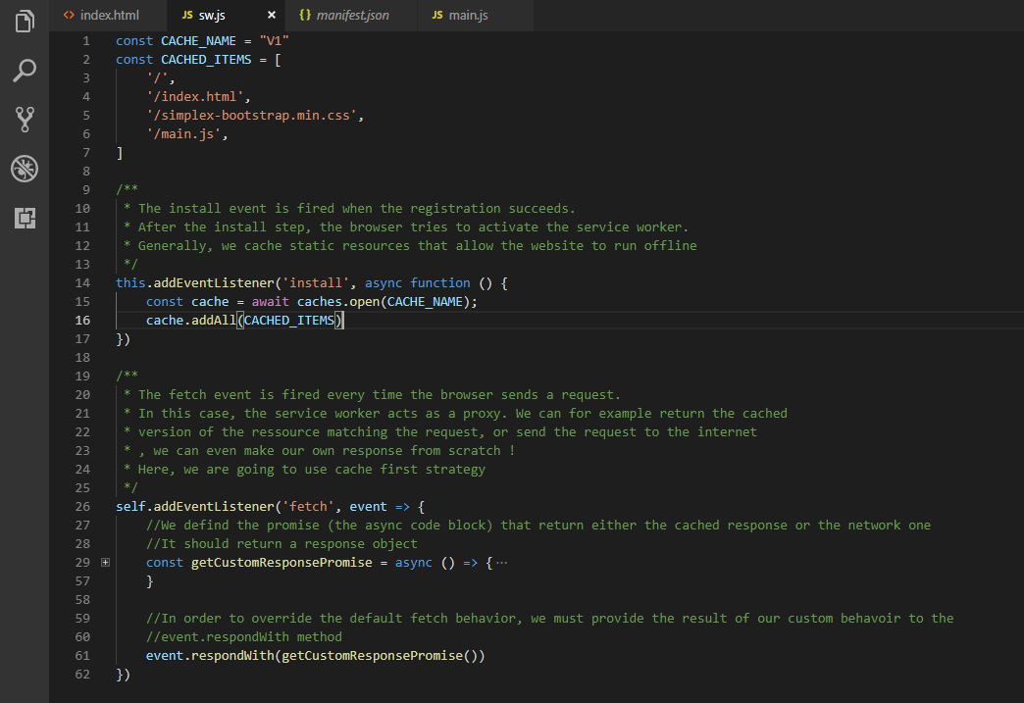
SW.JS

Slide 20
And that’s it
Open Your web browser and play with me
Enter: IP:5500

Slide 21
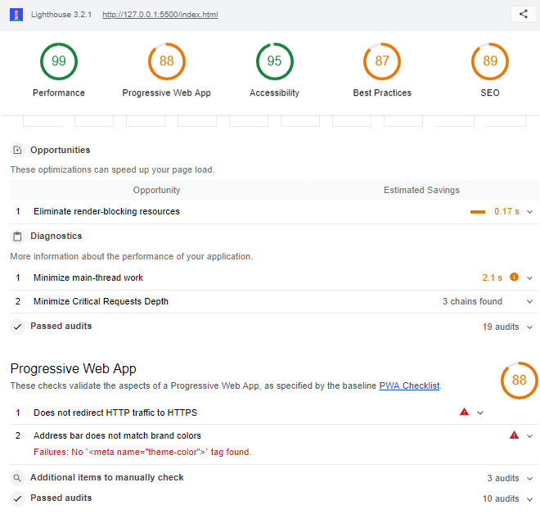

LightHouse Report
Lighthouse is an open-source, automated tool for improving the performance, quality, and correctness of your web apps.
When auditing a page, Lighthouse runs a barrage of tests against the page, and then generates a report on how well the page did. From here you can use the failing tests as indicators on what you can do to improve your app.

Slide 22
References
Demo with specific details
GitHub Repository

Slide 23
The End

